Slide 1
How Do You Get 100’s Of New Clients In Less Than One Week…
Without Writing A Single Check!!!

Slide 2
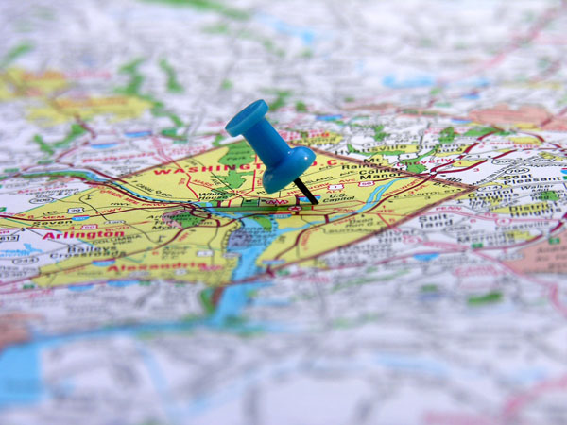
You Come Up With A Great Deal…

Slide 3
Your Deal Is Your Sample…

Slide 4
I Also Partner With Community Schools And Charities To Bring You Neighborhood Clients
Your Local Marketing Consultant Promotes It To Families Within 5 Miles Of Your Business

Slide 5
Hundreds Of New Clients Will “Sample” Your Business

Slide 6
Local Marketing Is The Key…
Results:
303 Vouchers Sold in 4 Days
Generated $2,954 for Restaurant, $545 Went To A Local School (Who Helped Promote The Deal To Their Local Families)

Slide 7
What’s In It For You?
Benefits For Merchants:
Merchant Never Writes A Check – Ever!
64% Of Sales – Not 50% Like Many Of The Others
Cash upfront (Paid Instantly!)
Merchant sets their terms of redemption – (How Many, When, Frequency, etc.)
No graphics or writing costs
Draws neighborhood buyers & from surrounding communities
New customers – Now!
Totally measurable results
Local Subscribers are already looking for our deals:
They sign up to receive daily emails with deals like yours
They can’t wait to open their email each day

Slide 8
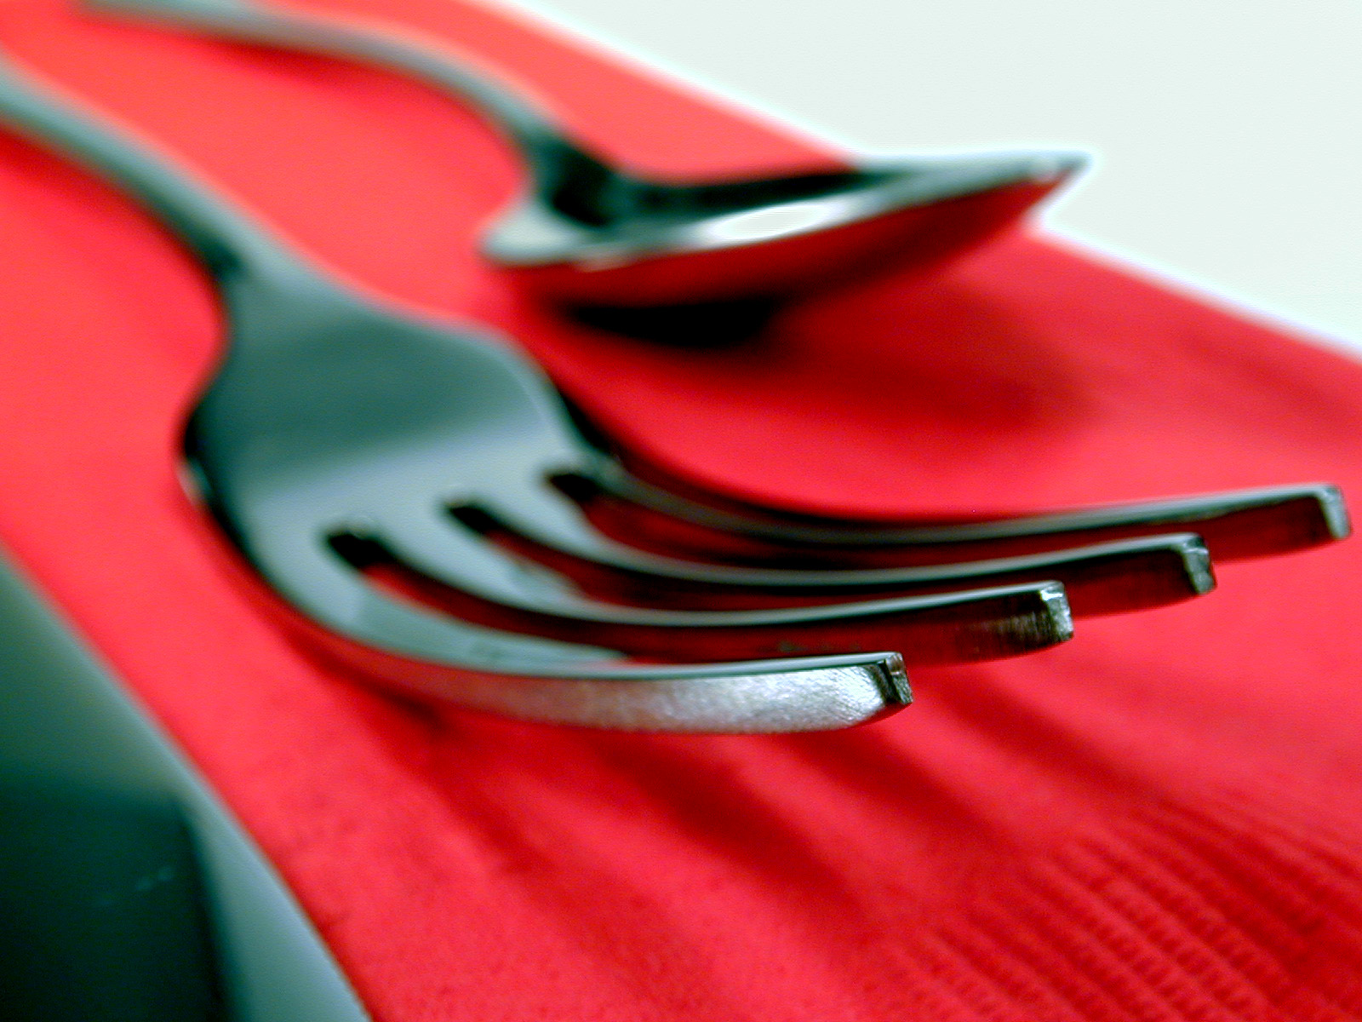
Call Your YipDeals Local Marketing Consultant Today!
Your LMC is ____________________: He/She can reached at __________ or xyz@email.com

